Slide 1

Bài xx: Unit test
Giảng viên: Nguyễn Quang Huy
Email: HuyNQ12@topica.edu.vn
‹#›

Slide 2
1.Purpose of software tests
A software test is a piece of software, which executes another piece of software. It validates if that code results in the expected state (state testing) or executes the expected sequence of events (behavior testing)
Software unit tests help the developer to verify that the logic of a piece of the program is correct.
Running tests automatically helps to identify software regressions introduced by changes in the source code.

Slide 3
2.Testing terminology
The code which is tested is typically called the code under test
A test fixture is a fixed state in code which is tested used as input for a test
A unit test is a piece of code written by a developer that executes a specific functionality in the code to be tested and asserts a certain behavior or state
The percentage of code which is tested by unit tests is typically called test coverage
An integration test aims to test the behavior of a component or the integration between a set of components
Performance tests are used to benchmark software components repeatedly. Their purpose is to ensure that the code under test runs fast enough even if it’s under high load.
A test is a behavior test (also called interaction test) if it checks if certain methods were called with the correct input parameters. A behavior test does not validate the result of a method call
Notes:
A unit test targets a small unit of code, e.g., a method or a class. External dependencies should be removed from unit tests, e.g., by replacing the dependency with a test implementation or a (mock) object created by a test framework.
Unit tests are not suitable for testing complex user interface or component interaction. For this, you should develop integration tests
An integration test aims to test the behavior of a component or the integration between a set of components. The term functional test is sometimes used as synonym for integration test. Integration tests check that the whole system works as intended, therefore they are reducing the need for intensive manual tests.

Slide 4
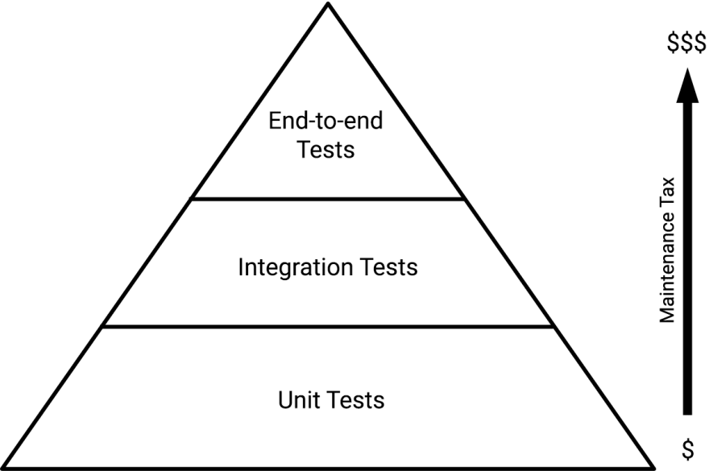

Slide 5
2.Testing frameworks for Java
spring-boot-starter-test
JUnit 4
Mockito
Hamcrest
JsonAssert

Slide 6

‹#›

Slide 7
3.Test replacements (test doubles)
A unit test should test functionality in isolation. Side effects from other classes or the system should be eliminated for a unit test, if possible.
This can be done via using test replacements (test doubles) for the real dependencies. Test doubles can be classified like the following
A dummy object is passed around but never used, i.e., its methods are never called. Such an object can for example be used to fill the parameter list of a method
Fake objects have working implementations, but are usually simplified. For example, they use an in memory database and not a real database
A stub class is an partial implementation for an interface or class with the purpose of using an instance of this stub class during testing. Stubs usually don’t respond to anything outside what’s programmed in for the test. Stubs may also record information a
A mock object is a dummy implementation for an interface or a class in which you define the output of certain method calls. Mock objects are configured to perform a certain behavior during a test. They typically record the interaction with the system and test

Slide 8

‹#›

Slide 9
Task
CalculateService
public int sum(int a, int b)
public int multiple(int a, int b)
public int device(int a, int b)
MyService
public float[] calculate(int a, int b, int c)
Viết unit test cho function device(chia) & function calculate(giải phương trình bậc 2)
‹#›

